Slide 1

Heart Disease Prediction by using machine learning
Instructor: Dr. Muhammed El-Sayeh

Slide 2
Table of contents
01
02
03
04
Introduction
Problem statement and Goal
About dataset
Rows and column, handling missing value, preprocessing, and main figures
Model training and Evaluations
Models trained, best model, and final evaluation
conclusion

Slide 3
01
Introduction

Slide 4

Problem statement & Goal
Late diagnosis of heart disease is common
People avoid costly checks or ignore symptoms
Project goal: fast, affordable, early detection using simple medical data
Could be used by individuals or doctors
Potential future app

Slide 5

Dataset Overview

Slide 6
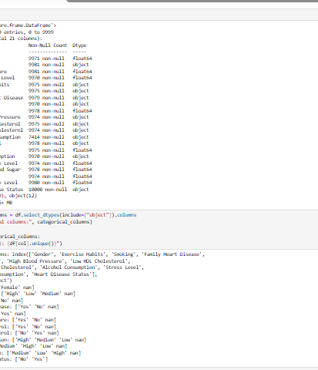
About Dataset
10,000 records, 21 columns
Includes: age, gender, blood pressure, cholesterol, habits, history
Target: Heart Disease Status (Yes/No)
Missing values handled with KNNImputer

Slide 7

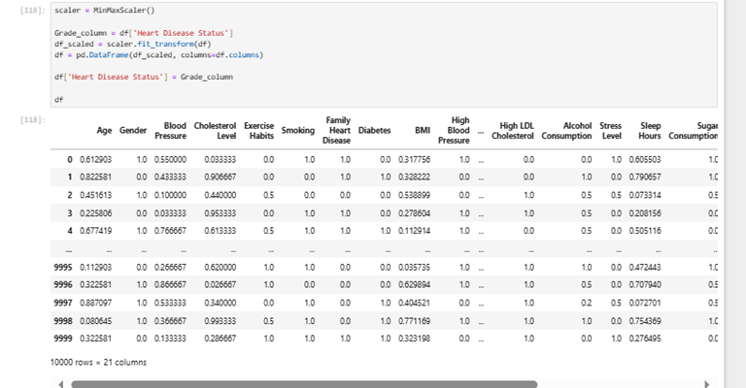
Preprocessing
Categorical variables encoded
MinMaxScaler is used to normalize numerical features
Class imbalance handled using SMOTE
No additional feature engineering needed

Slide 8
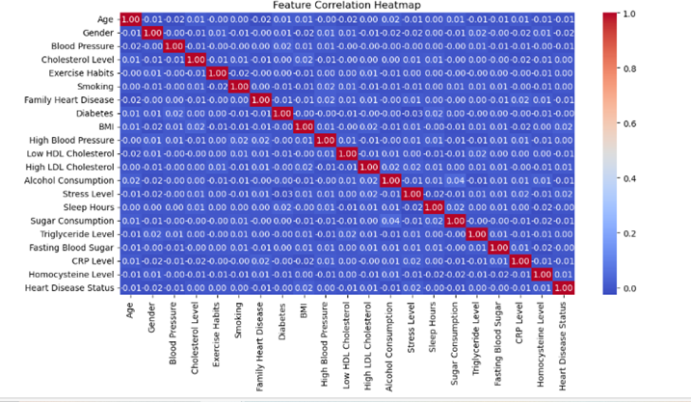
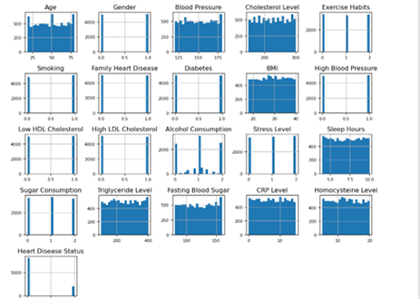
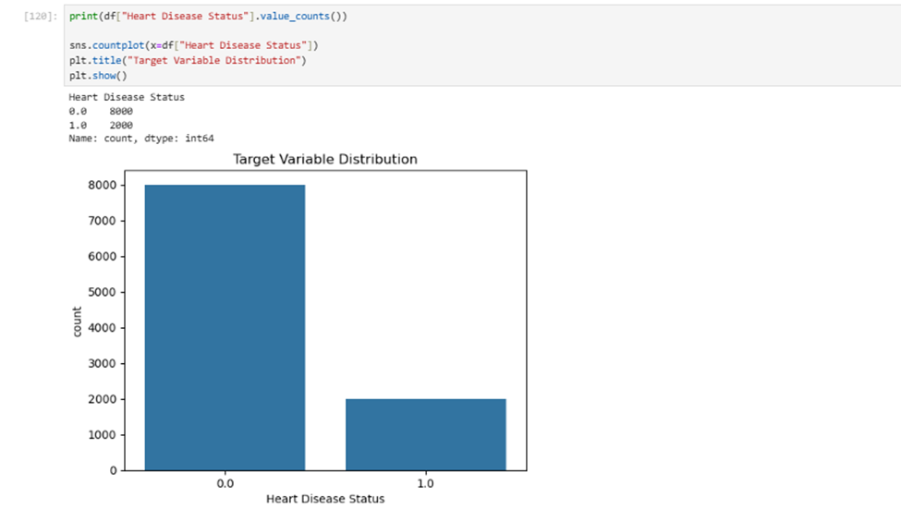
Distribution and outliers

Slide 9
Model Training & Evaluation

Slide 10
Models trained:
Random Forest
SVM
Logistic regression
KNN
Naïve bayes
Decision Tree

Slide 11
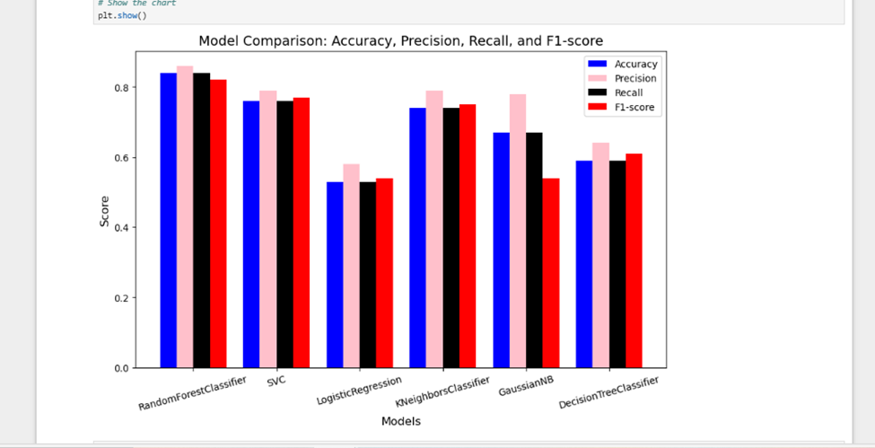
Model comparison
Evaluation:
Accuracy ,Precision,Recall,F1-Score, Confusion Matrix, ROC-AUC
Most precision and recall
Random forest
SVM
KNN

Slide 12
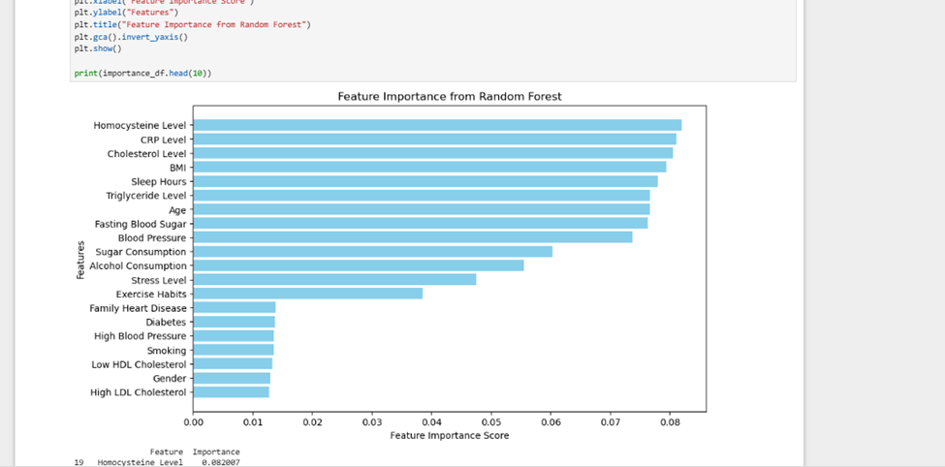
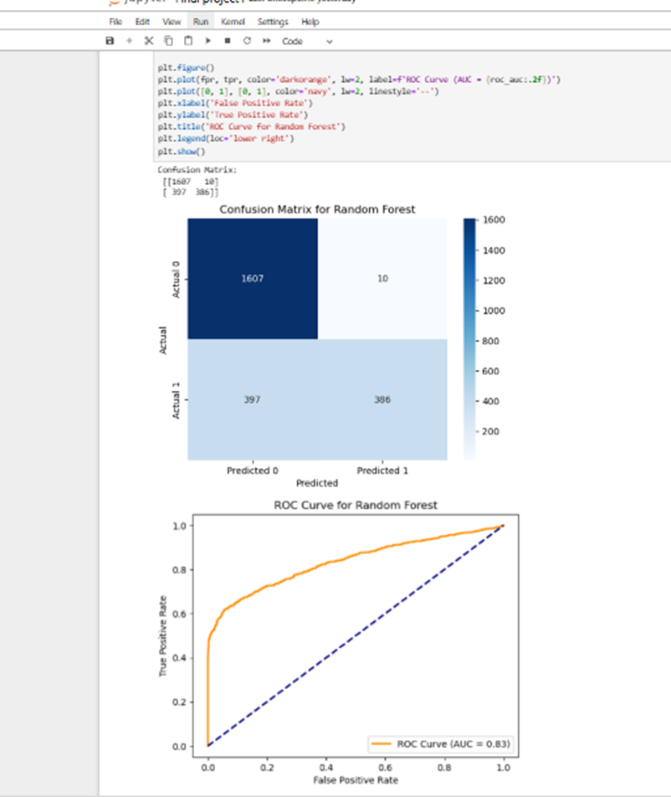
Best model –most important feature random forest
Accuracy: 83%, F1-score: 0.81
Handled class imbalance well
No undefined metrics
Most reliable overall
Top predictors:
CRP Level
Homocysteine
Cholesterol
BMI
Also: sleep hours, alcohol, exercise
Low importance: gender, LDL

Slide 13
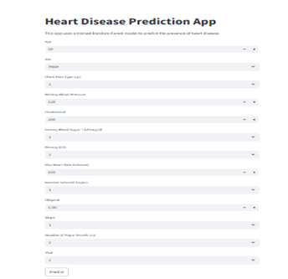
Final Evaluation
Confusion Matrix: Balanced predictions
ROC-AUC: 0.83
Streamlit app created for GUI

Slide 14
conclusion

Slide 15
Early prediction using ML is effective
Random Forest outperformed all others
Balancing data with SMOTE helped a lot
Model deployed as GUI for real-time use
Ready for clinical support or public app

Slide 16
Thanks!
Do you have any questions?

